Slide 1
Design Patterns
Dennis
July. 29 2015

Slide 2

1994 年
Gang of Four

Slide 3
什麼是 Design Pattern ?
A general reusable solution to a commonly occurring problem within a given context in software design

Slide 4
為什麼需要了解 Design Pattern?
解決重複一般性問題
增加程式的可維護性
共同的溝通語言
讓程式更有彈性

Slide 5
Gof(Gang Of Four) 模式
Creational Design Patterns (5)
Singleton, Factory, Abstract Factory, Builder, Prototype
Structural Design Patterns (7)
Adapter, Composite, Proxy, Flyweight, Façade, Bridge, Decorator
Behavioral Design Patterns (11)
Template Method, Mediator, Chain of Responsibility, Observer, Strategy, Command, State, Visitor, Interpreter, Iterator, Memento

Slide 6
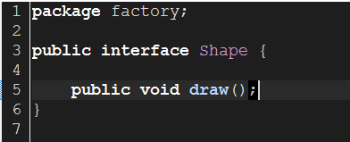
Factory Pattern
In Factory pattern, we create object without exposing the creation logic to the client and refer to newly created object using a common interface

Slide 7
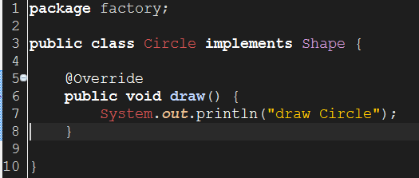
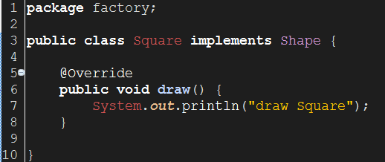
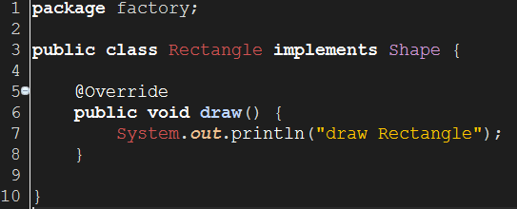

Slide 8
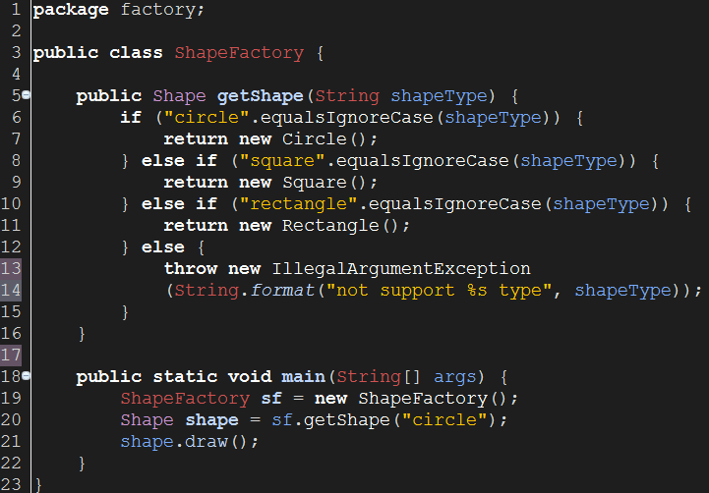

Slide 9
Builder Pattern
Builder pattern builds a complex object using simple objects and using a step by step approach

Slide 10
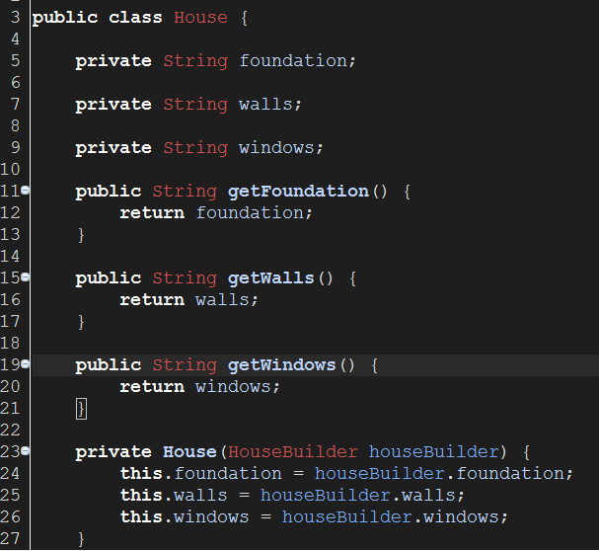

Slide 11
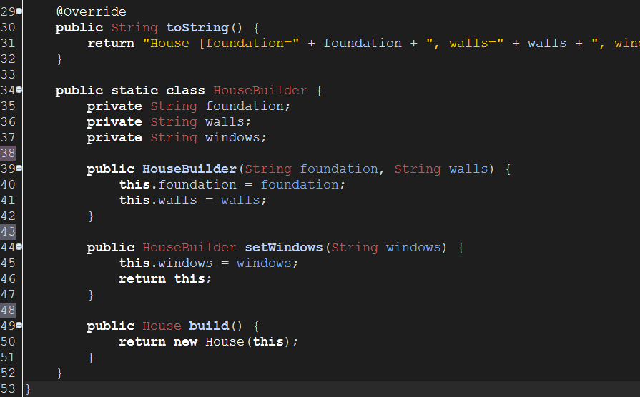

Slide 12
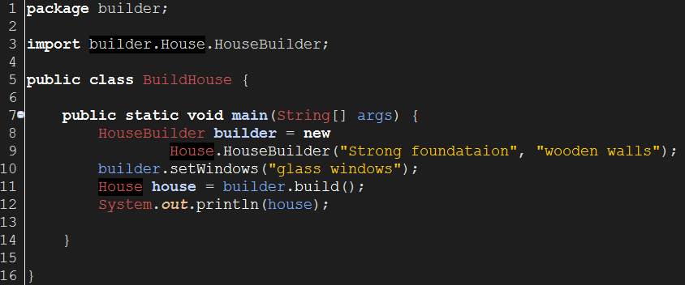


Slide 13
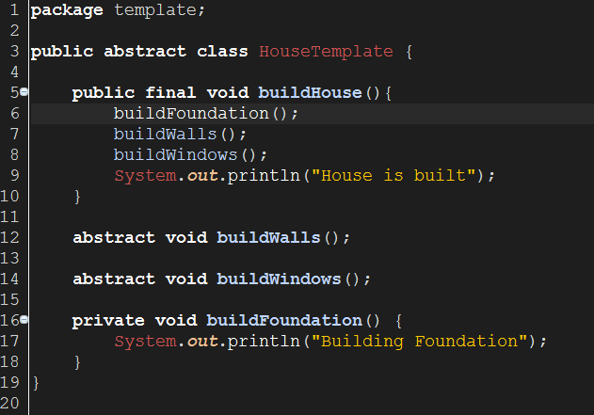
Template Method

Slide 14
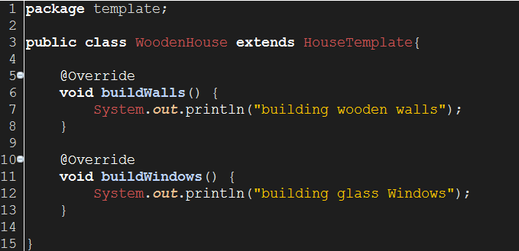
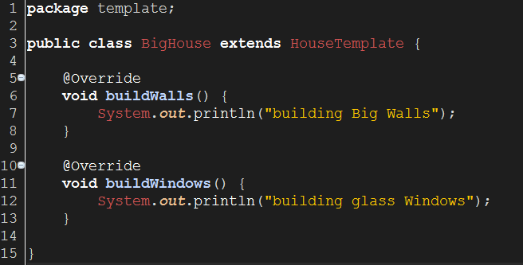

Slide 15
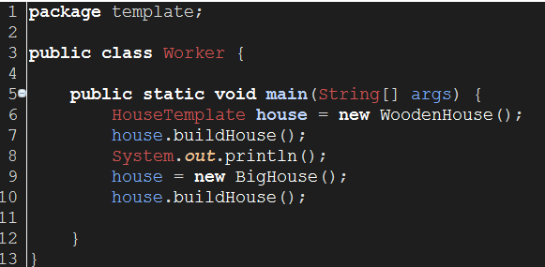
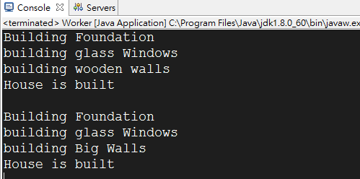

Slide 16
Memento Pattern
Originator : Originator is the object whose state needs to be saved and restored
Caretaker : Caretaker is the helper class that is responsible for storing and restoring the Originator’s state through Memento object
Memento : The memento object itself is an opaque object

Slide 17
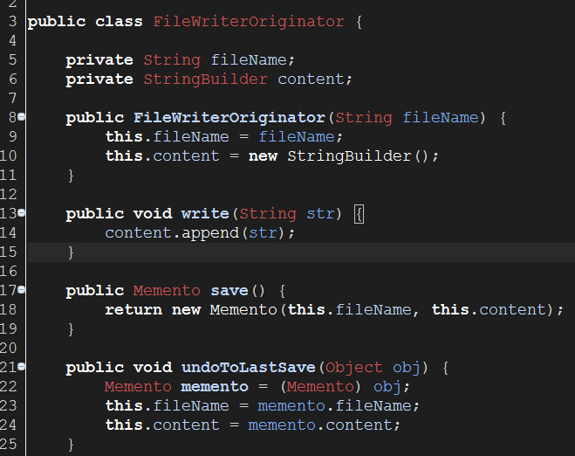

Slide 18
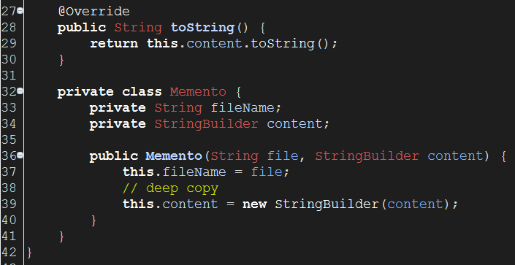

Slide 19
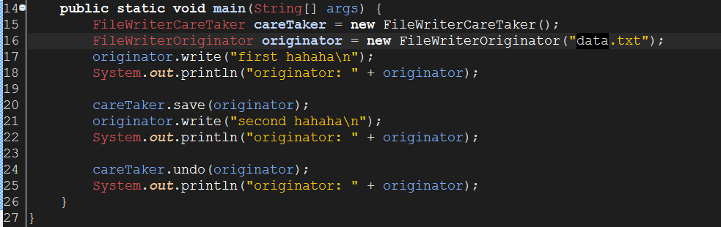
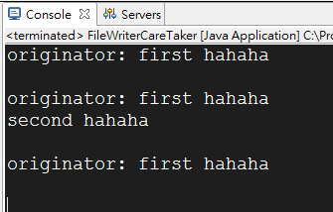

Slide 20
參考資料
http://www.journaldev.com/1827/java-design-patterns-example-tutorial#decorator-pattern
http://www.tutorialspoint.com/design_pattern/index.htm
https://en.wikipedia.org/wiki/Software_design_pattern

